Slide 1


Project Review Presentation
SECURE AND INTERPERTABLE CREDIT SCORING WITH FEDERATED AI
DEEBAK G R 22CS043
KOWSICK K 22CS083

Slide 2
Abstract & Overview
The rapid rise of digital finance has created an urgent need for advanced, automated credit scoring. However, this evolution brings significant challenges, primarily concerning data privacy, the opacity of AI models, and data silos.
The Challenge
Our Solution: TrustFed
Growing privacy concerns with sensitive financial data.
TrustFed leverages two cutting-edge technologies:
Lack of transparency in "black-box" AI models.
Federated Learning (FL): For secure, decentralized model training without data sharing.
Inefficiency due to fragmented data in silos.
Explainable AI (SHAP): To ensure transparency and interpretability of credit decisions.
Our primary goal with TrustFed is to deliver a credit scoring system that ensures privacy, transparency, and trust in every decision.

Slide 3




Problem Statement
Traditional credit scoring systems, reliant on centralized data, face significant hurdles in the modern financial landscape.
Centralization & Privacy Risks
Centralized credit scoring models inherently require sensitive customer data to be aggregated, creating single points of failure and increasing privacy risks.
Cross-Bank Data Sharing
Customers' confidential financial data is often shared across different banks or institutions, raising concerns about data security and compliance.
Black-Box AI Models
Many modern machine learning models used in credit scoring operate as "black boxes," offering high predictive power but no insight into their decision-making process, leading to distrust and difficulty in auditing.
Increasing Regulatory Pressure
Stricter data protection regulations, such as GDPR and India's RBI guidelines, mandate greater control over personal data and transparency in automated decision-making, posing compliance challenges for existing systems.

Slide 4




Objectives
Our TrustFed project is designed to achieve four key objectives that address the identified challenges in credit scoring.
Multi-Bank Collaboration
To facilitate secure collaboration among multiple financial institutions without the direct exposure or sharing of raw, sensitive customer data.
Accurate Federated Model
To develop and validate an accurate federated credit scoring model that maintains high predictive performance comparable to centralized models.
Explainability with SHAP
To integrate SHAP (Shapley Additive Explanations) to provide robust and interpretable explanations for individual credit decisions, enhancing trust and regulatory compliance.
Practical FinTech Framework
To deliver a robust and practical FinTech framework that effectively balances privacy, interpretability, and predictive performance in a real-world banking context.

Slide 5
Scope of Work
Our project focuses on a targeted scope to demonstrate the effectiveness and applicability of TrustFed.
Simulated Collaboration
Data & Benchmarking
We will simulate a collaborative environment between Bank A and Bank B to model real-world multi-institution scenarios.
The project will utilize the well-known German Credit Dataset for robust benchmarking and evaluation.
Key Techniques
Future Scalability
Federated Averaging (FedAvg): As the core federated learning algorithm for model aggregation.
The framework is designed to be extendable to larger, real-world multi-bank collaborations, paving the way for broader adoption in the financial industry.
SHAP (Shapley Additive Explanations): For delivering interpretable insights into model predictions.

Slide 6
Literature Review
Our project builds upon existing research while addressing a critical gap in the intersection of privacy-preserving machine learning and explainability.
Traditional Credit Scoring
1
Primarily used Logistic Regression and other statistical models.
Centralized data processing: Transparent due to simpler models, but with limitations in handling complex data and privacy.
2
Federated Learning (FL)
Pioneered by Google in 2017 for privacy-preserving ML on distributed datasets.
Growing adoption in finance: Addresses data silos and privacy concerns by keeping data localized.
Explainable AI (XAI)
3
Techniques like SHAP and LIME emerged to provide interpretability for complex ML models.
Crucial for building trust and ensuring fairness in critical applications like credit scoring.
Identified Gap: While FL and XAI are robust fields, there are very few works that effectively combine both for privacy-preserving and explainable credit scoring. This intersection represents our significant contribution.

Slide 7
Methodology Overview
Our TrustFed project follows a systematic methodology to develop and validate the federated credit scoring system.
01
02
Data Collection
Preprocessing
Gathering and organizing credit datasets from simulated Bank A and Bank B, along with the public German Credit Dataset.
Cleaning, encoding categorical features, and scaling numerical features to prepare the data for model training.
03
04
Local Training
Federated Averaging
Each simulated bank independently trains its local credit scoring model on its private dataset.
A central server aggregates the learned parameters (weights) from each local model to create a robust global model.
05
06
Evaluation
Explainability with SHAP
The global model's performance is rigorously evaluated using unseen data from Bank B and the German dataset.
Applying SHAP to both local and global models to explain individual credit decisions and understand feature importances.

Slide 8

Federated Learning Workflow
The core of TrustFed lies in its Federated Learning (FL) workflow, ensuring data privacy while facilitating collaborative model development.
Bank A Local Model
Train on local bank A data
Bank B Local Model
Train on local bank B data
TrustFed Privacy
Data never leaves bank premises
Aggregator (Server)
Perform Federated Averaging
Global Model
Distribute updated model to banks
This cyclical process ensures that financial institutions can benefit from a powerful, collaboratively trained credit scoring model without ever sharing their sensitive raw data.

Slide 9
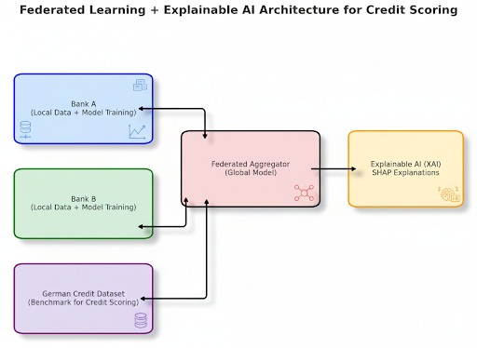
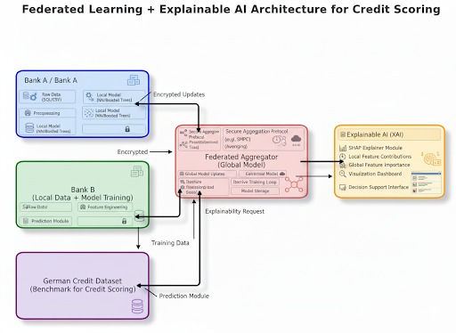
ARCHIETURE DIAGRAM

Slide 10


Privacy-Preserving Mechanisms
TrustFed's architecture is designed with privacy at its forefront, implementing multiple layers to protect sensitive financial data.
No Raw Data Sharing
Secure Aggregation
Optional Enhancements
The fundamental principle of TrustFed: raw customer transaction data or personal information never leaves the client's (bank's) premises.
Only encrypted model updates (weights, not data) are sent to the central aggregator, which combines them securely using cryptographic techniques to prevent reverse-engineering of individual data.
Differential Privacy: Adding controlled noise to model updates to further obscure individual contributions.
Homomorphic Encryption: Enabling computations on encrypted data, maintaining privacy even during aggregation.
This multi-faceted approach ensures full compliance with stringent data protection regulations like GDPR, upholding principles of data minimization and purpose limitation by design.

Slide 11
THANK YOU

